Slide 1
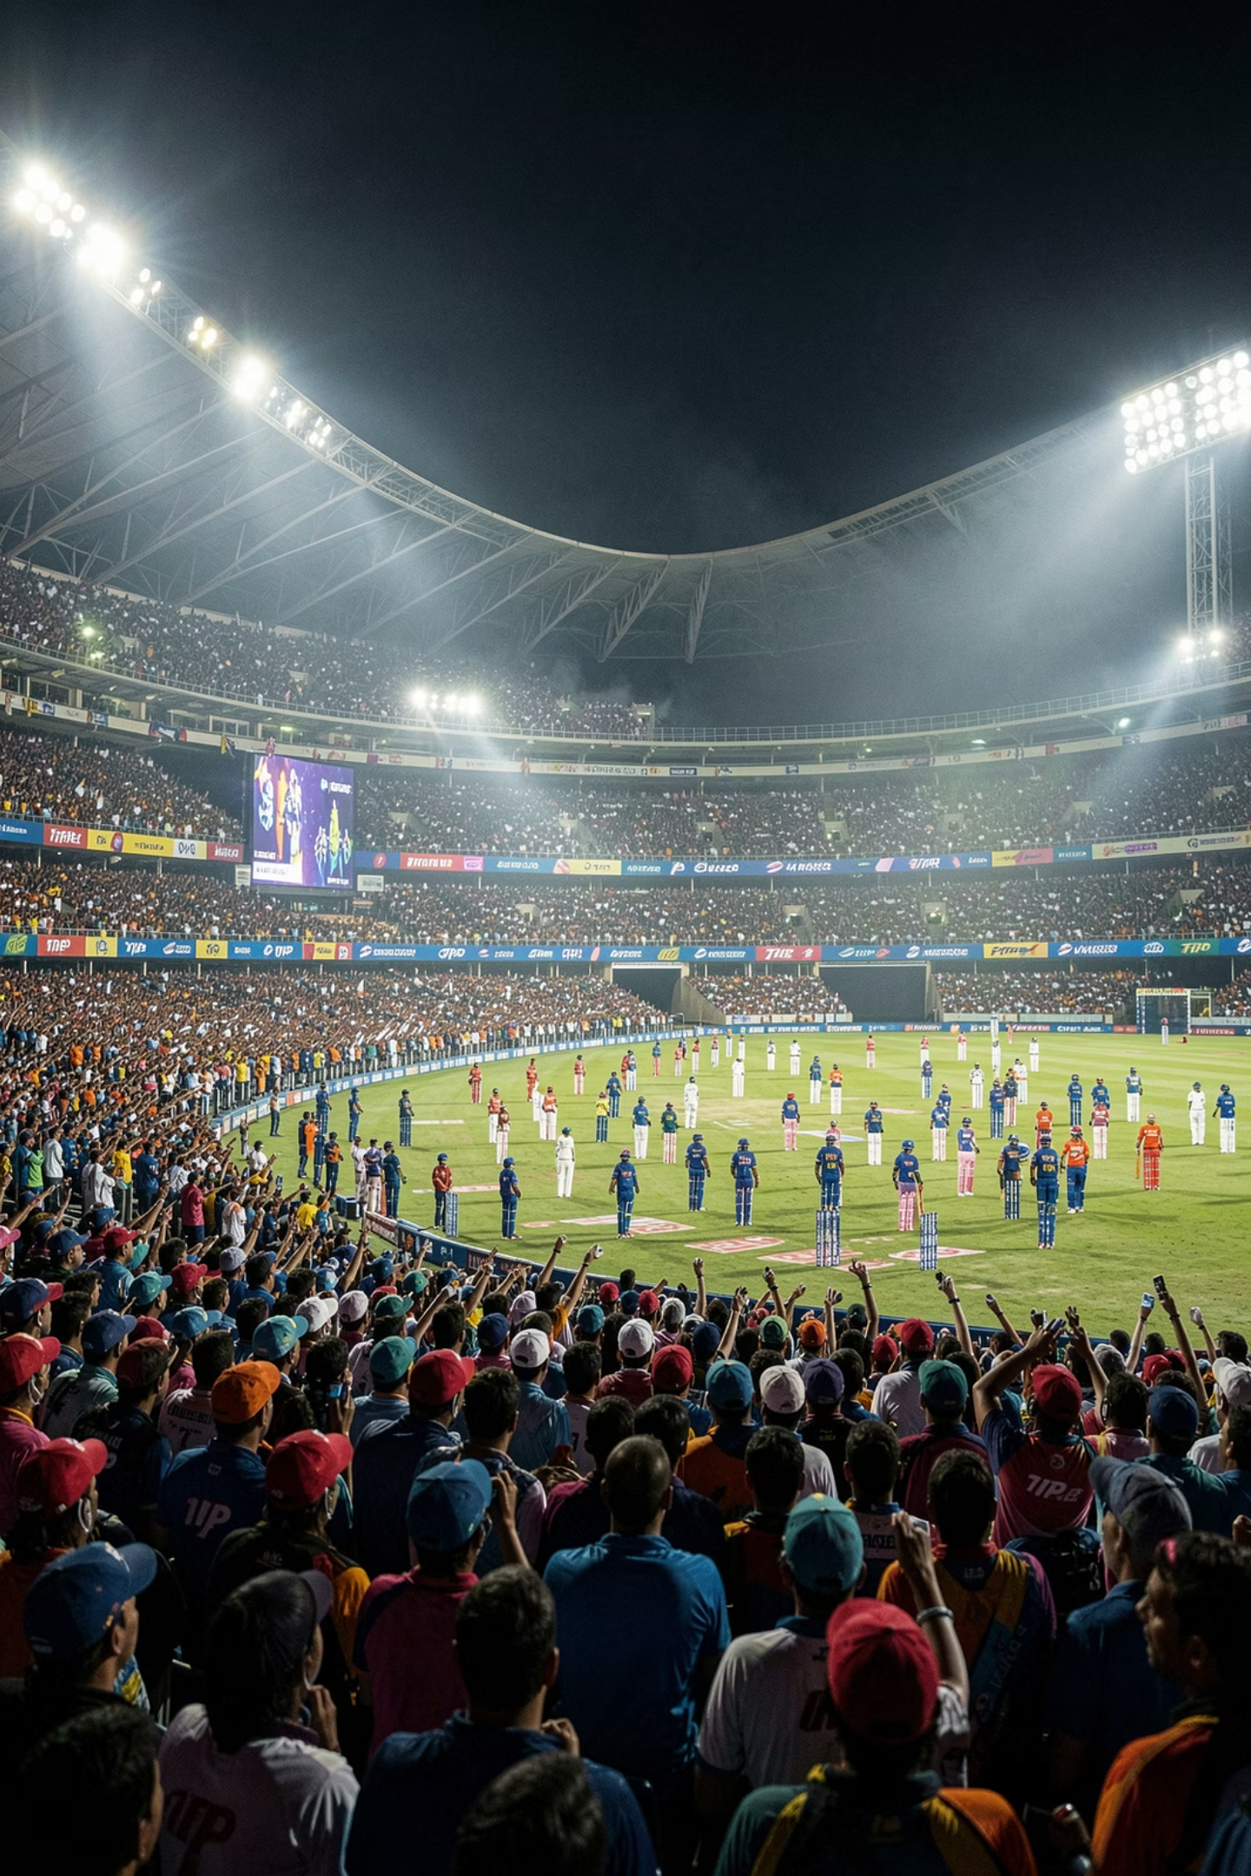
IPL Analysis
A data-driven exploration of match patterns, player performance, toss impact, and venue insights across IPL seasons.
PRESENTED BY KIRAN MIRJE

Slide 2

Introduction & Objectives
Problem Statement
IPL generates vast amounts of match and player data every season. Without structured analysis, identifying performance trends, player effectiveness, venue impact, and match-winning factors becomes extremely difficult.
Key Focus Areas
Team Performance Analysis
Player Performance Analysis
Toss Impact Analysis
Venue-wise Evaluation
Season-wise Trends & Match Result Patterns

Slide 3
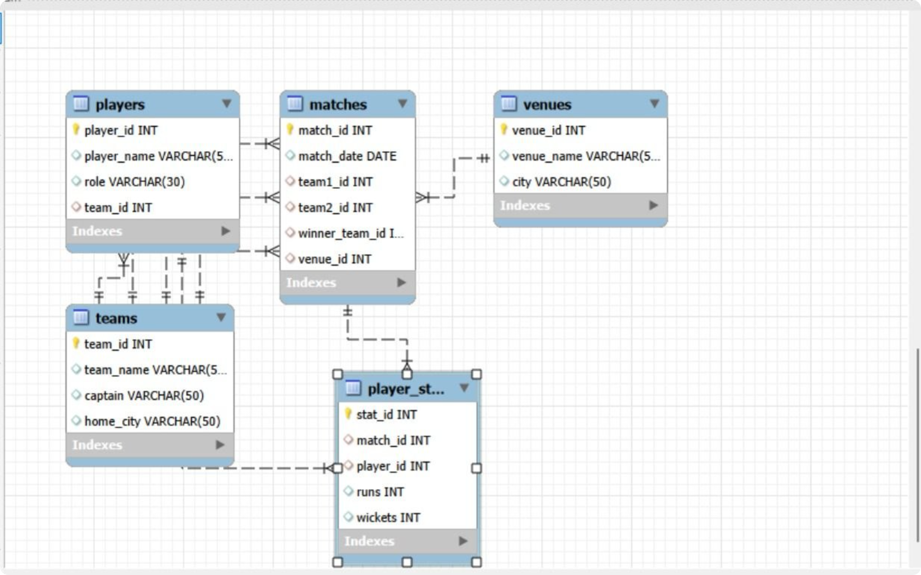
Data Architecture: ER Diagram
The analysis is built on a relational database schema connecting five core entities. This structure enables seamless joins across matches, players, teams, venues, and statistics — forming the backbone of every query in this study.
Matches
Players
Teams
Venues
Core match records
Player master data
Franchise details
Ground information
Player Stats
Performance metrics

Slide 4
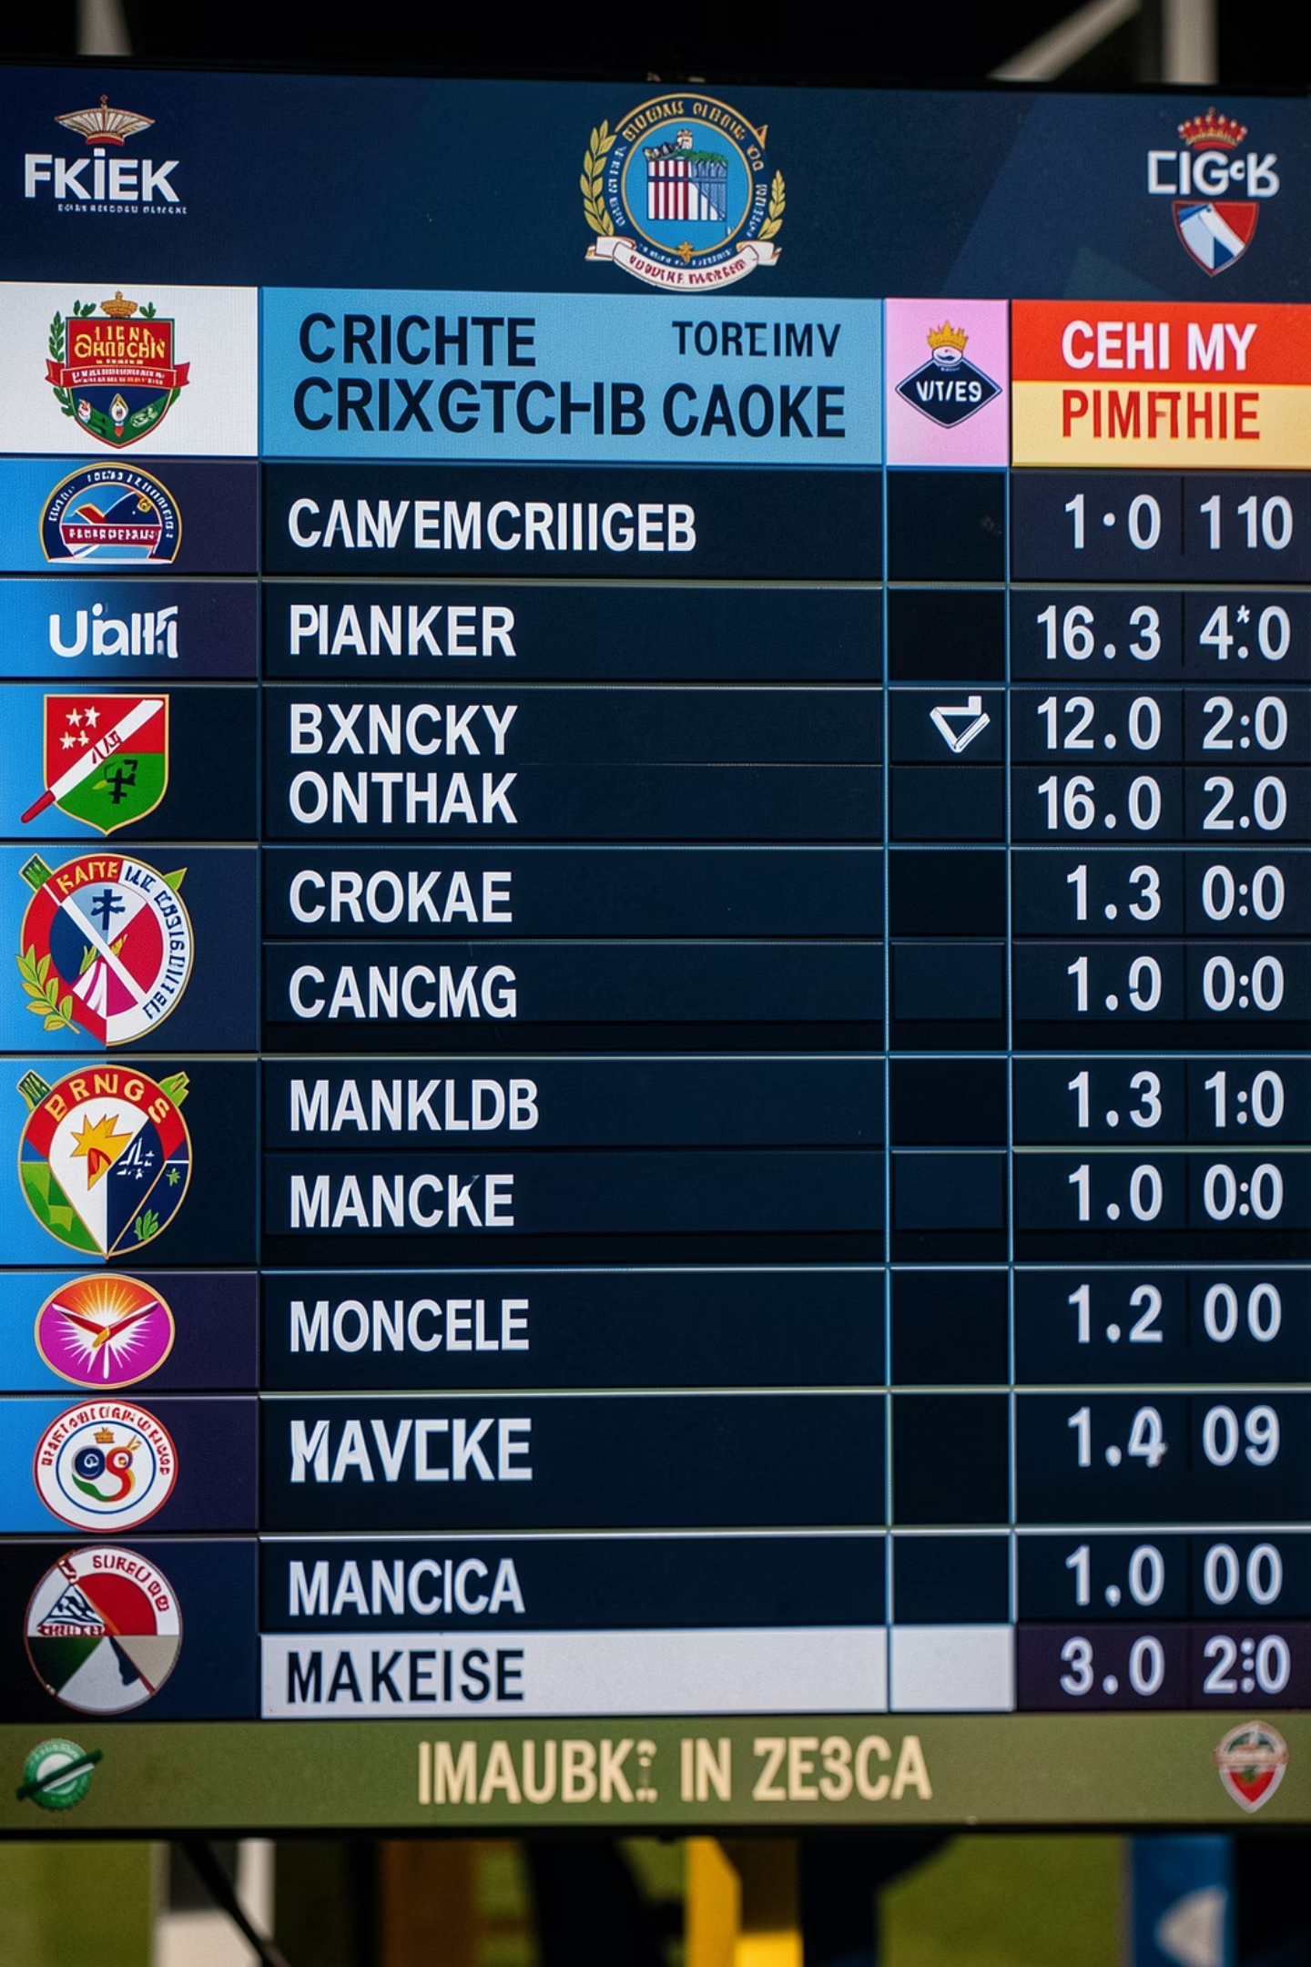


Foundational Queries
Query 1 — Total Matches Played
Counts the total number of matches recorded in the database using a simple aggregate on the matches table.
SELECT COUNT(*) AS total_matches FROM matches;
Query 2 — Match Winners with Venue
Joins matches, teams, and venues to map every winning team to its venue — revealing venue-wise dominance patterns.
SELECT m.match_id, t.team_name AS winner, v.venue_name
FROM matches m
JOIN teams t ON m.winner_team_id = t.team_id
JOIN venues v ON m.venue_id = v.venue_id;

Slide 5
Aggregate Function Queries
Query 3 — Total Players
Query 4 — Total Runs per Player
Counts the total number of player records to establish the dataset's scale.
Aggregates runs across all matches per player, ordered descending to rank batsmen by cumulative output.
SELECT COUNT(*) AS total_matches
FROM matches;
SELECT p.player_name, SUM(ps.runs) AS total_runs
FROM player_stats ps
JOIN players p ON ps.player_id = p.player_id
GROUP BY p.player_name
ORDER BY total_runs DESC;

Slide 6
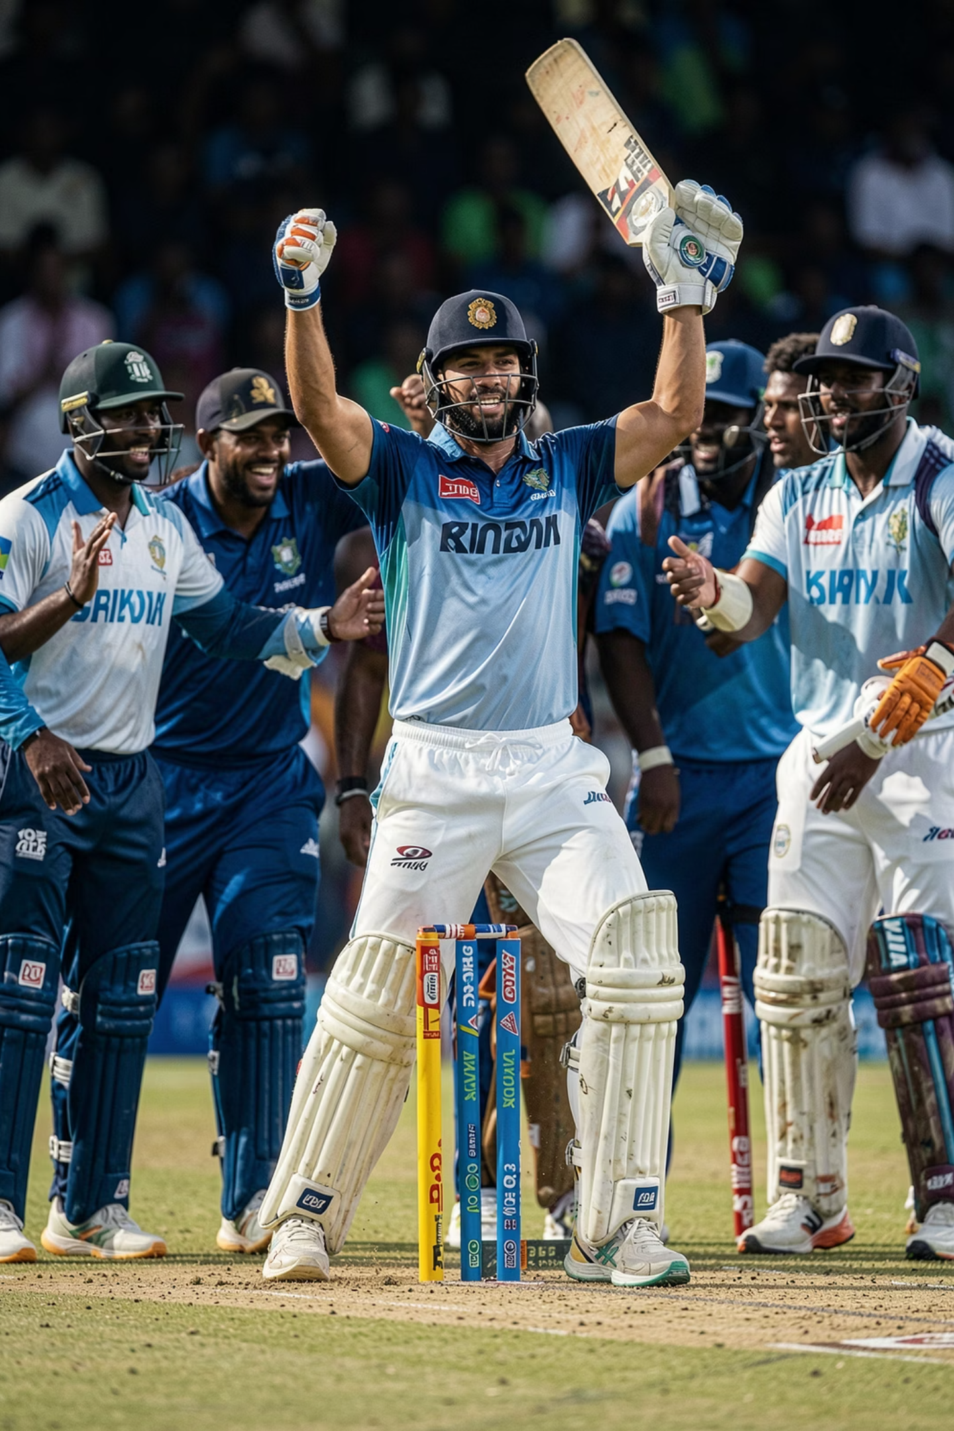

Wickets & Top Run-Scorer
Query 5 — Total Wickets per Player
Aggregates wickets across all matches per bowler, ranked in descending order to identify the most effective wicket-takers.
SELECT p.player_name, SUM(ps.wickets) AS total_wickets
FROM player_stats ps
JOIN players p ON ps.player_id = p.player_id
GROUP BY p.player_name
ORDER BY total_wickets DESC;
Query 6 — Highest Run Scorer
Identifies the single highest run-scorer across the dataset using the same aggregation pattern, ordered by total runs descending.
SELECT p.player_name, SUM(ps.runs) AS total_runs
FROM player_stats ps
JOIN players p ON ps.player_id = p.player_id
GROUP BY p.player_name
ORDER BY total_runs DESC;

Slide 7

Top Performance Queries
Query 7 — Highest Wicket Taker
Query 8 — Top 3 Batsmen
Applies LIMIT 1 to isolate the single most prolific bowler in the dataset.
Extends the run-scoring query with LIMIT 3 to surface the three most productive batsmen — a quick leaderboard view for analysts.
SELECT p.player_name, SUM(ps.wickets) AS total_wickets
FROM player_stats ps
JOIN players p ON ps.player_id = p.player_id
GROUP BY p.player_name
ORDER BY total_wickets DESC
LIMIT 1;
SELECT p.player_name, SUM(ps.runs) AS total_runs
FROM player_stats ps
JOIN players p ON ps.player_id = p.player_id
GROUP BY p.player_name
ORDER BY total_runs DESC
LIMIT 3;
These foundational SQL queries form the analytical backbone for deeper IPL performance studies — from team comparisons to venue impact assessments.

Slide 8

Key Takeaways & Future Scope
Quantifiable Performance
Data-Driven Strategy
Venue Conditions
Our analysis provides actionable insights for teams, players, and broadcasters. Future enhancements could include predictive modeling for match outcomes and deeper player performance metrics.
Enhanced Decision Making
Deeper Player Scouting
Fan Engagement
Strategic insights for team composition and match planning.
Identify hidden talent and assess player value more accurately.
Provide richer statistics and narratives for commentators and fans.

Slide 9
THANK YOU

